Slide 1
Pedestrian Movement in Melbourne
Sharleen Othman

Slide 2
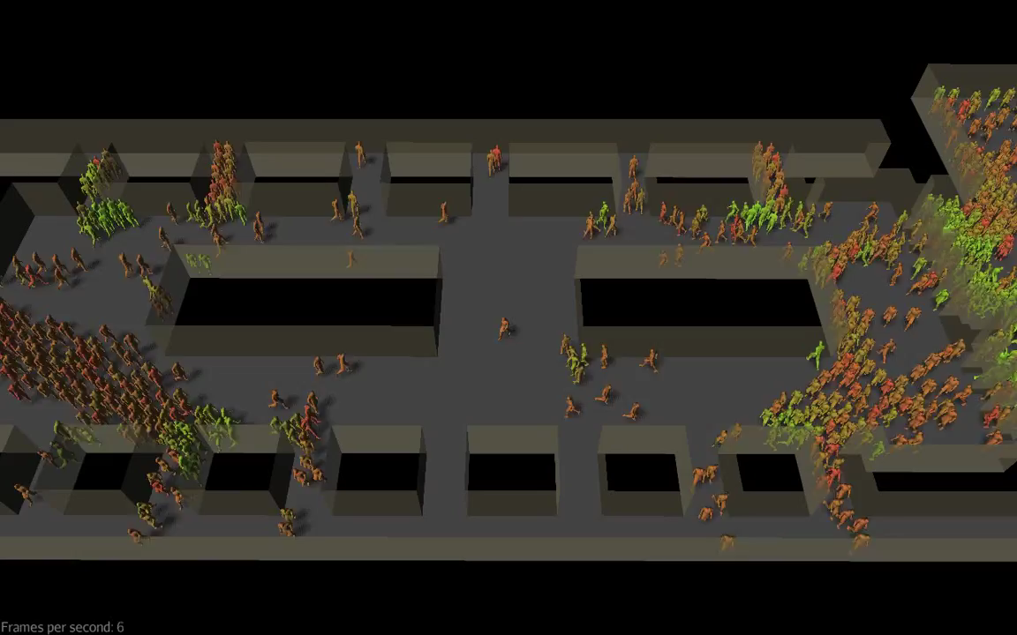
Do our movements have a pattern?
Notes:
I wanted to look at the patterns in the way we move around in a space. We’re each our own individuals but very often we move along in crowds. Take for example, leaving a venue after an event. everyone starts crowding towards the exits. Usually the exits are highlighted for us, there’ll be a couple of exits. A lot of us are going to follow the crowd to the nearest one, some of us know certain exits are closer to our cars, so we’ll move to those. But it’s with this majority that we can identify patterns with.
But we all follow a certain pattern depending on our surroundings or the place we live in.
Video Source:
Pedestrian simulation | Dynamic route assignment over continuous space
https://www.youtube.com/watch?v=QWuHTXufElU

Slide 3
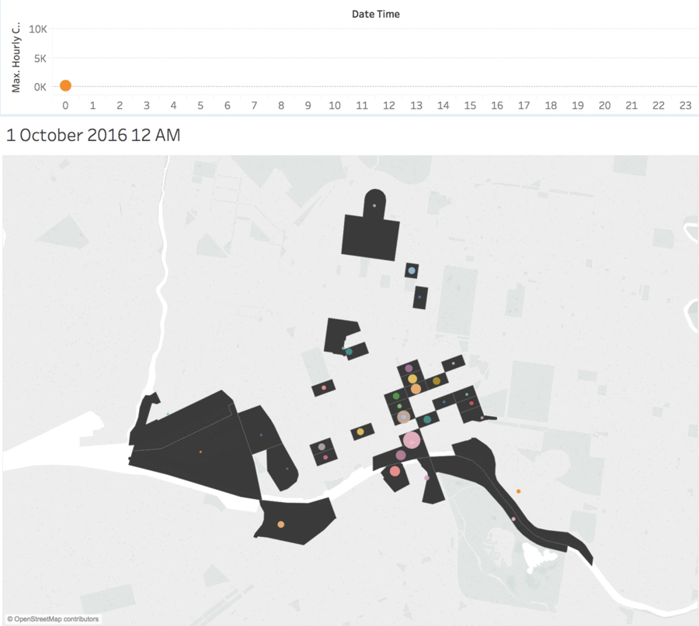
What patterns do pedestrians follow in a city?
Notes:
So what about in a city? This is movement in Melbourne during the AFL Grand Final, you can see in the bottom right corner in Birrarung, the bubble getting bigger in noon time where a bunch of people are going into the grounds to watch the game and then again at 6pm to go home. During this time, areas with transport links start to spike as well, whilst others remain at a constant.
Same concept, after a long day at work, we follow the nearest exit or station to go home. Sometimes, we have somewhere else to go apart from home.
Weekend AFL Grand Final
Melbourne Cricket Ground

Slide 4
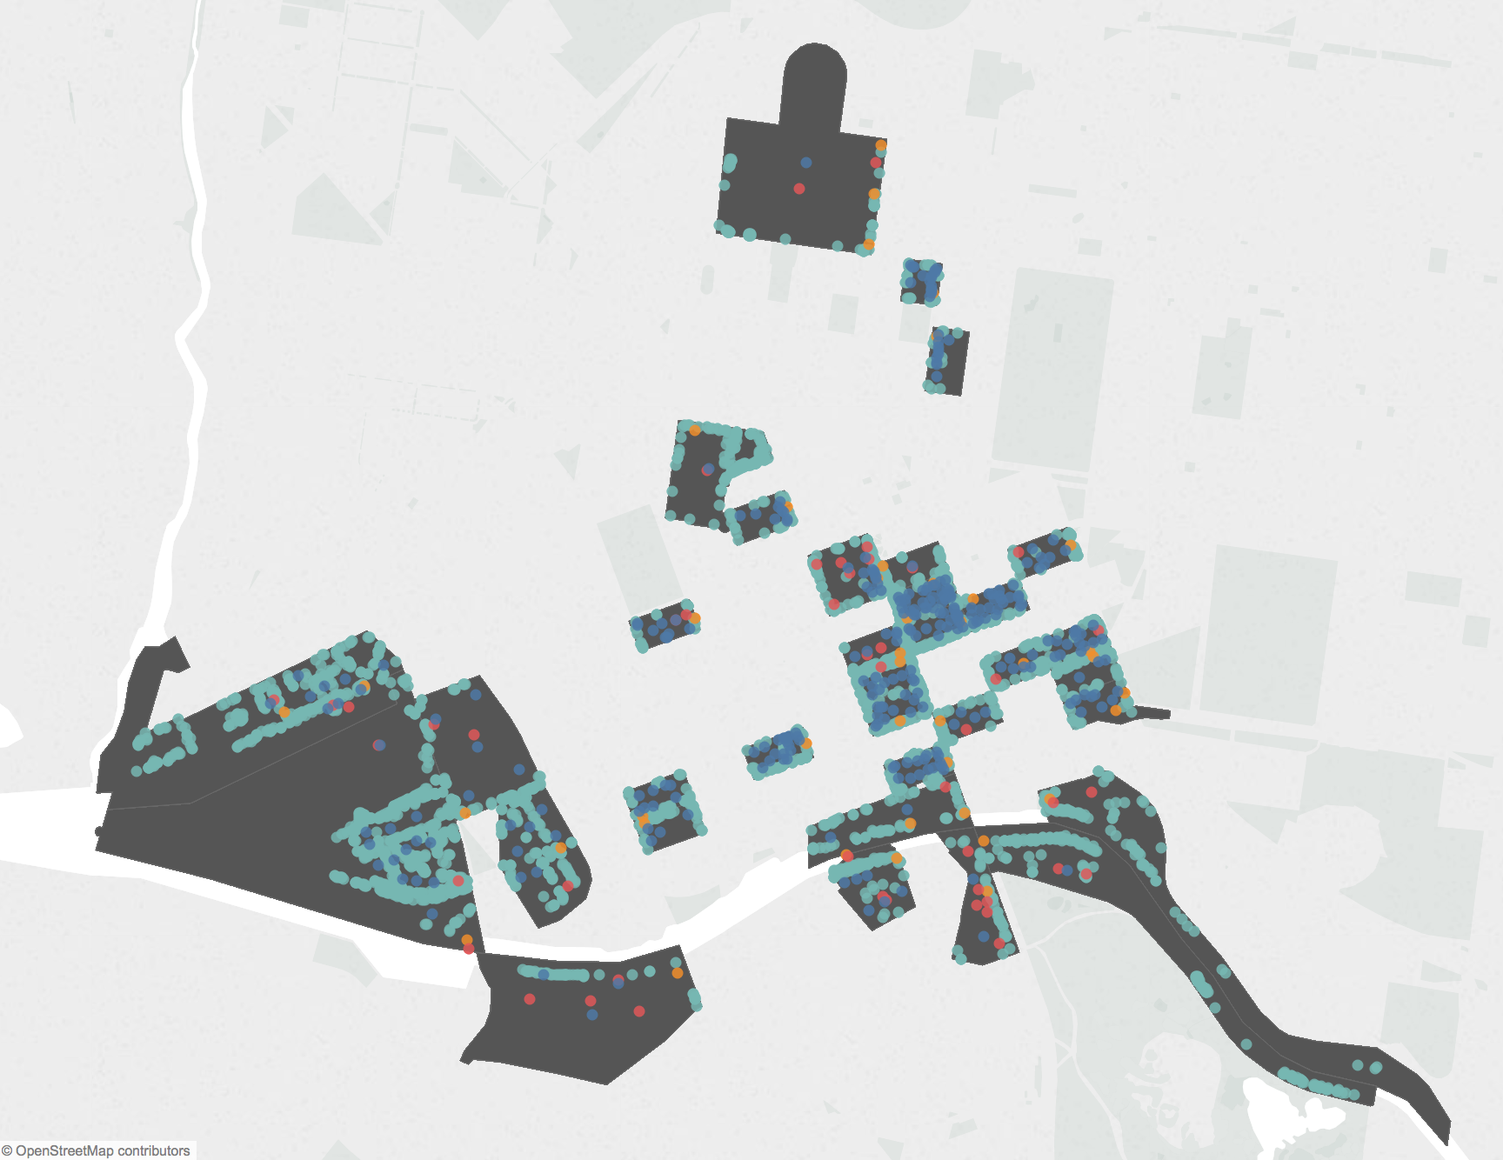
What’s in the area?
Events
Weather
Notes:
Knowing I have two specific pedestrian groups with different patterns, namely Commuters and Casuals, I looked across all different areas to identify which were more Commuter-dominant. Using PCA again, I was able to find these areas very well. In Melbourne, there were 10 locations out of the 42 that were Commuter-dominant. Note that commuter trends also show up in other areas but these 10 locations were the ones used by majority commuters.
Now we know daily patterns, what about month to month, yearly patterns

Slide 5
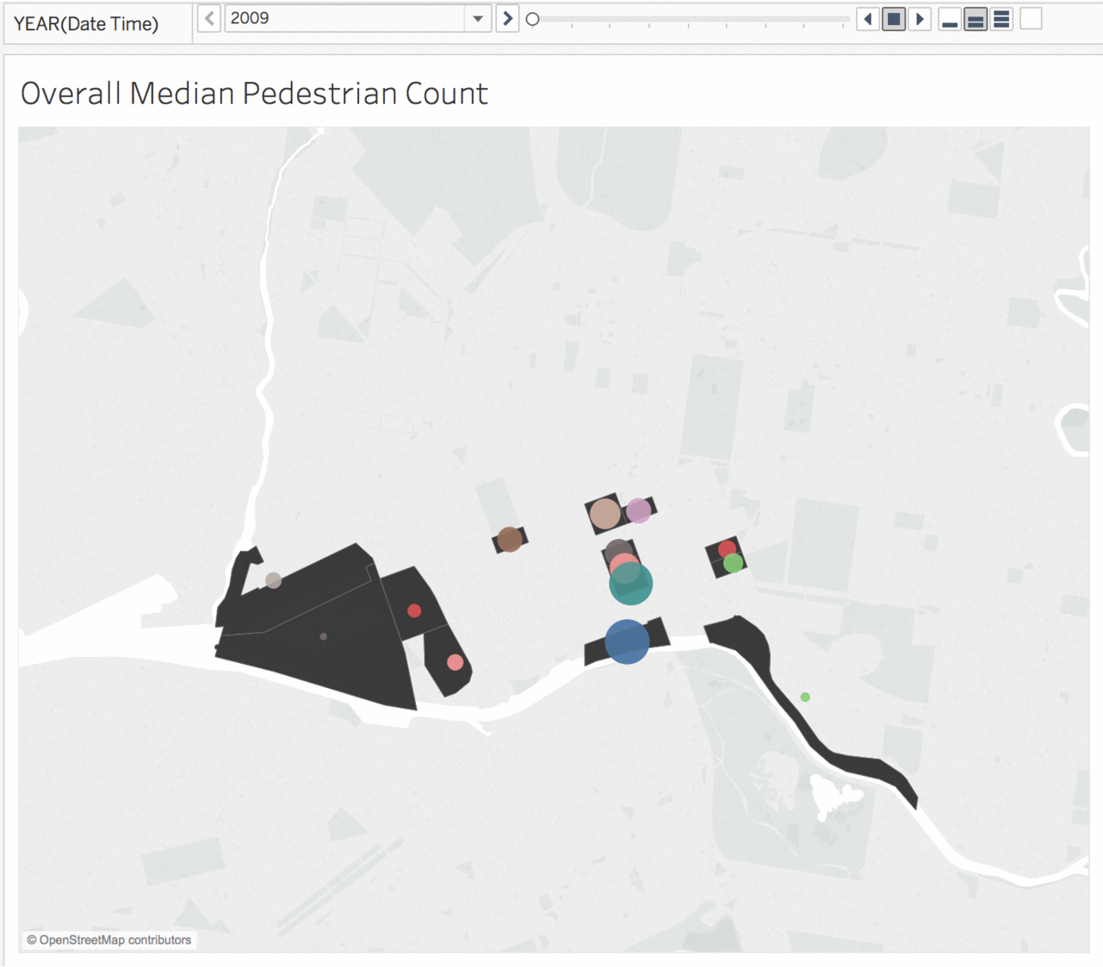
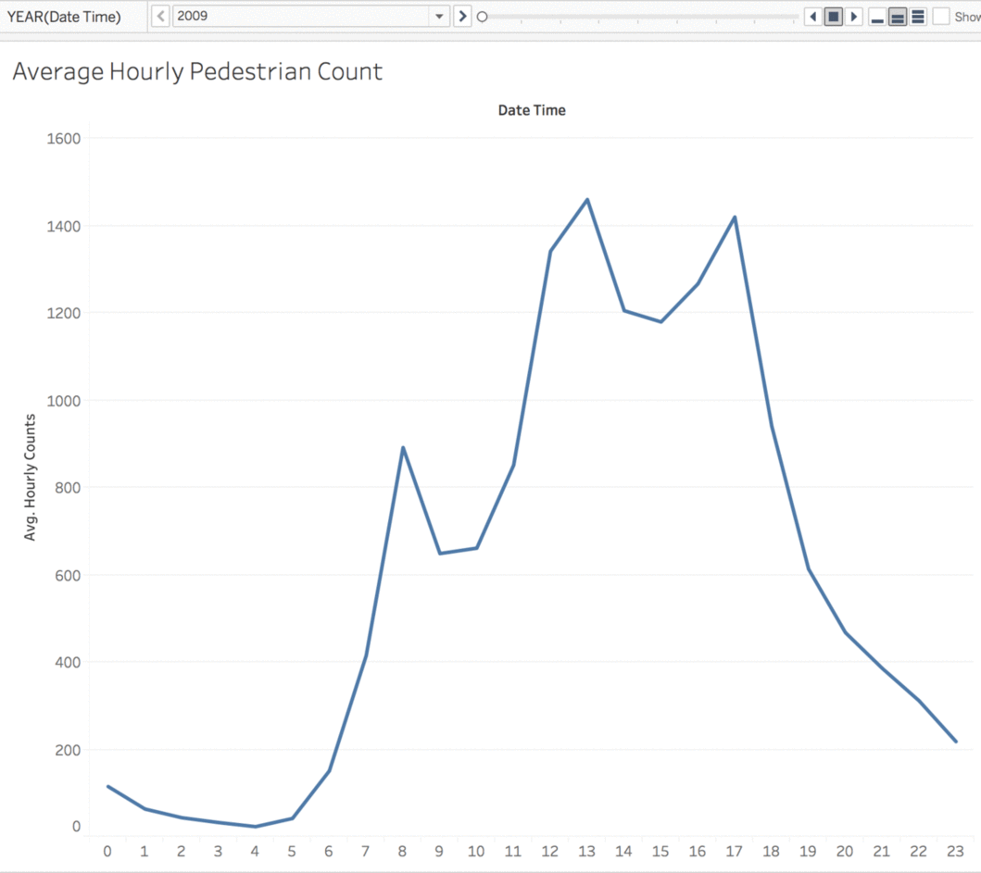
Rush Hours and Rush Areas
Notes:
Just like the venue example, there are certain places where people will crowd to at certain times.
Flinders Street and Southbank area is the most populated/most used areas in Melbourne.
8-12-5 Rush Hours
Weather data has been omitted from this analysis, and looking purely at pedestrian patterns and some physical features such as landmarks and businesses in the area
Just looking at this, there’s clearly patterns we can find. But a city is still filled with different individuals. Can I extract and identify hidden patterns or groups from this overall pattern?

Slide 6
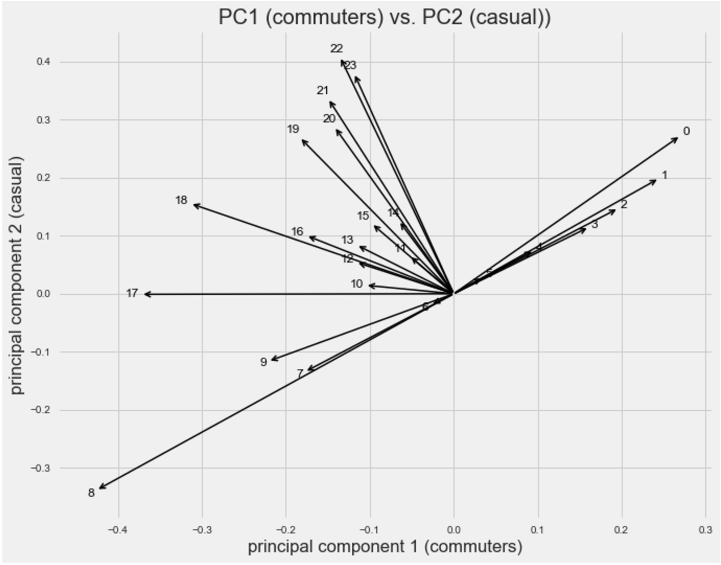
Pull Out Hidden Trends (PCA)
8am & 5pm
Notes:
It was a way for me to find out which times in the day matter the most in identifying different patterns. These two things were pedestrian counts at 8am and 5pm.
8am and 5pm is going to bed very useful for me in identifying differences in my pedestrian groups I’m trying to extract.

Slide 7
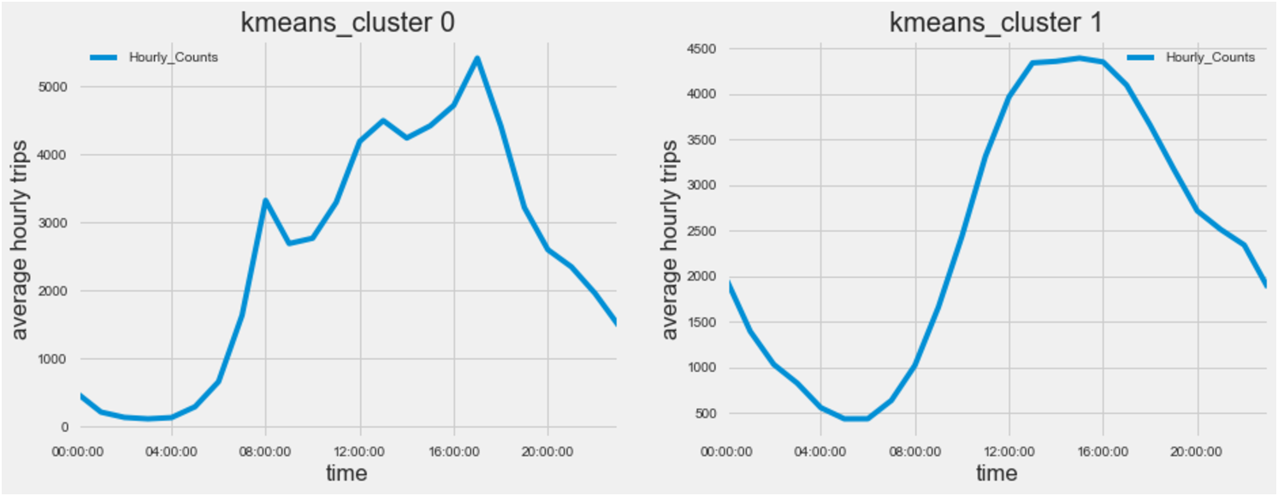
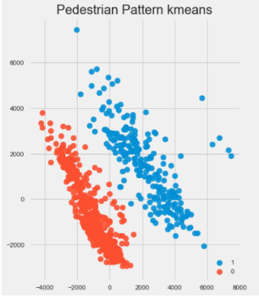
Two Groups (K-Means)
Notes:
For data scientists, this explained for 80% of variance in my data, meaning these two groups explained the majority types of pedestrians in Melbourne. Then Kmeans was used for unsupervised clustering.
Weekday and Weekend patterns.
Some days fall into ‘wrong group’ but can be explained by Holidays.

Slide 8
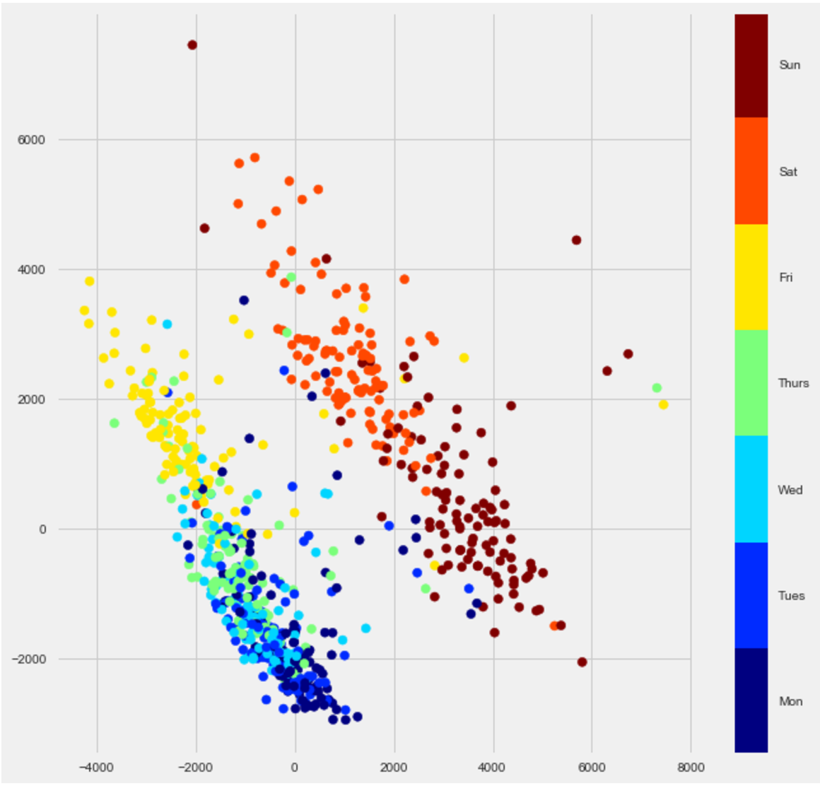
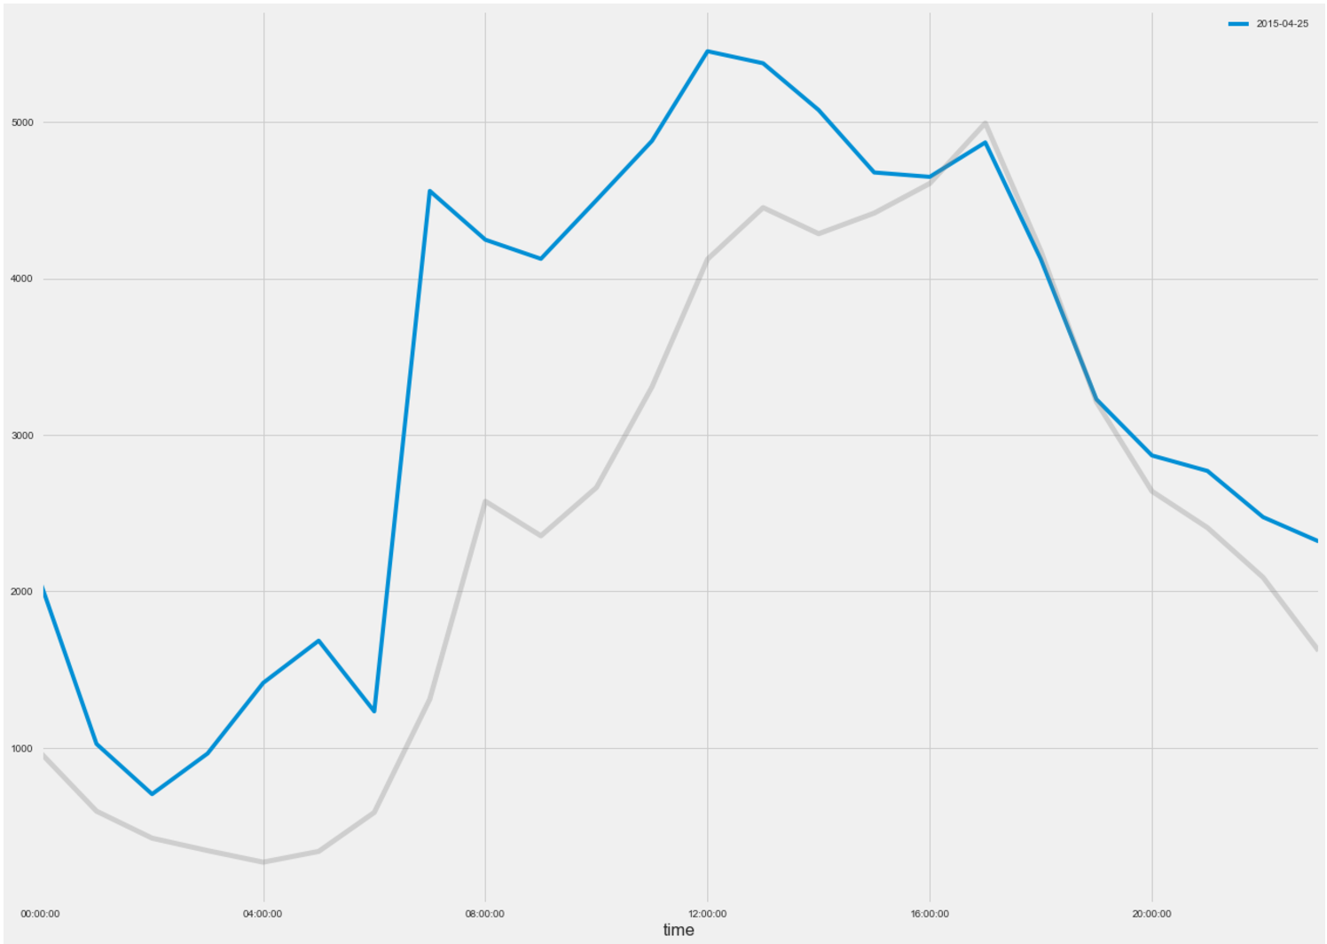
Weekends & Weekdays
Anzac Day Dawn Service

Slide 9
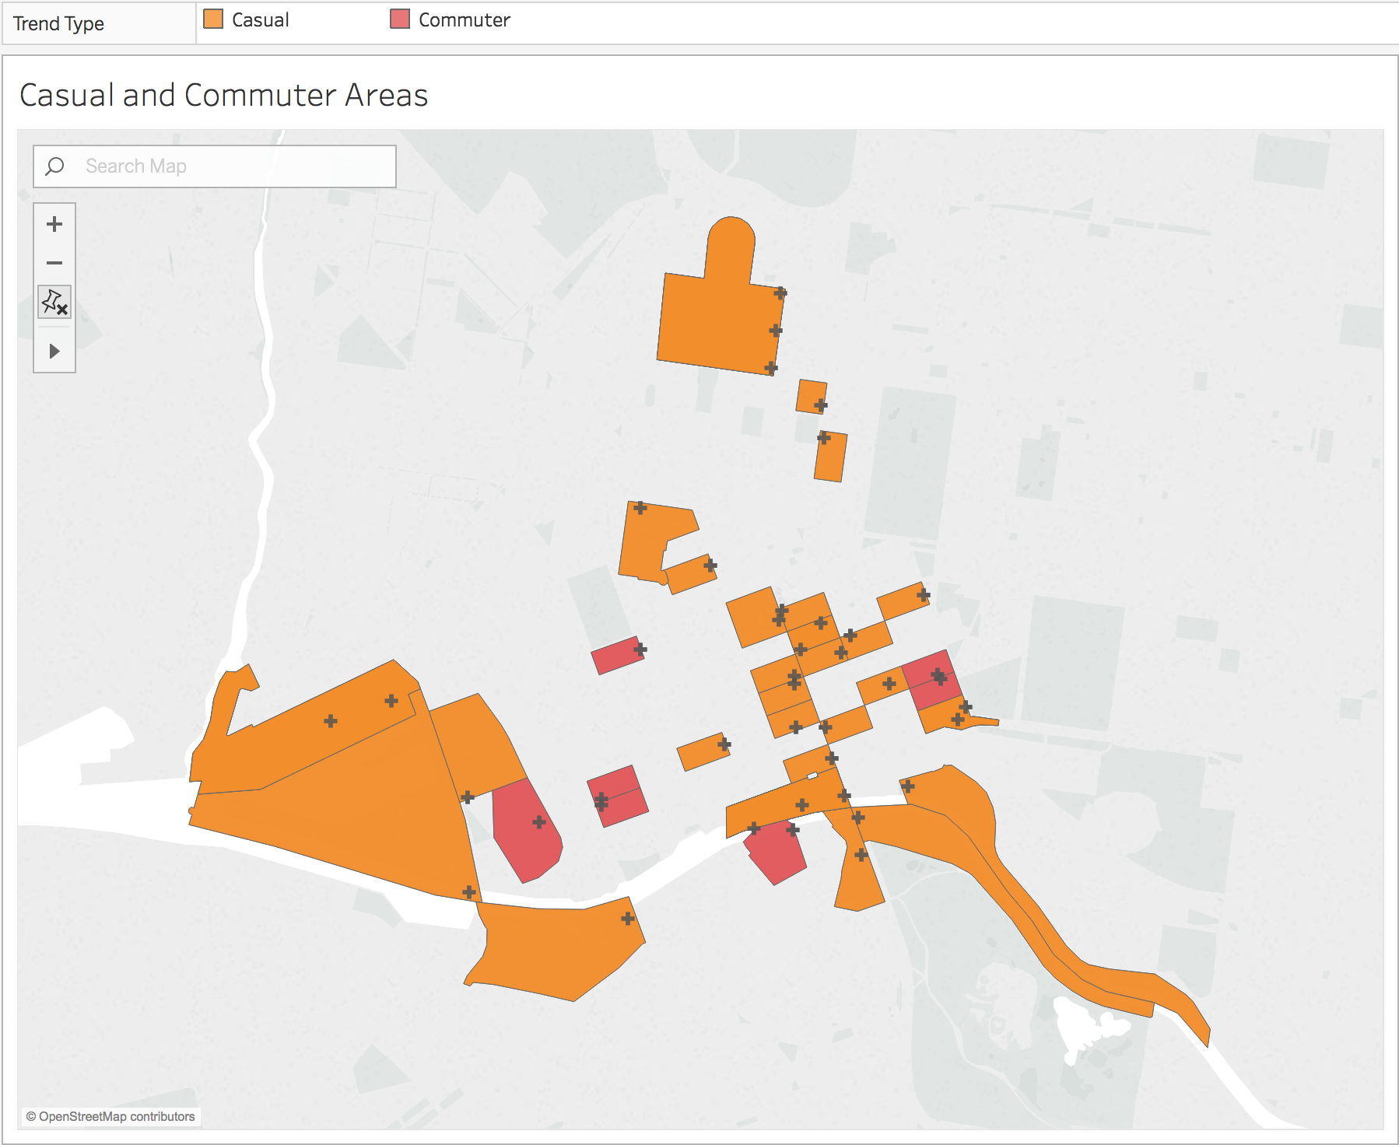
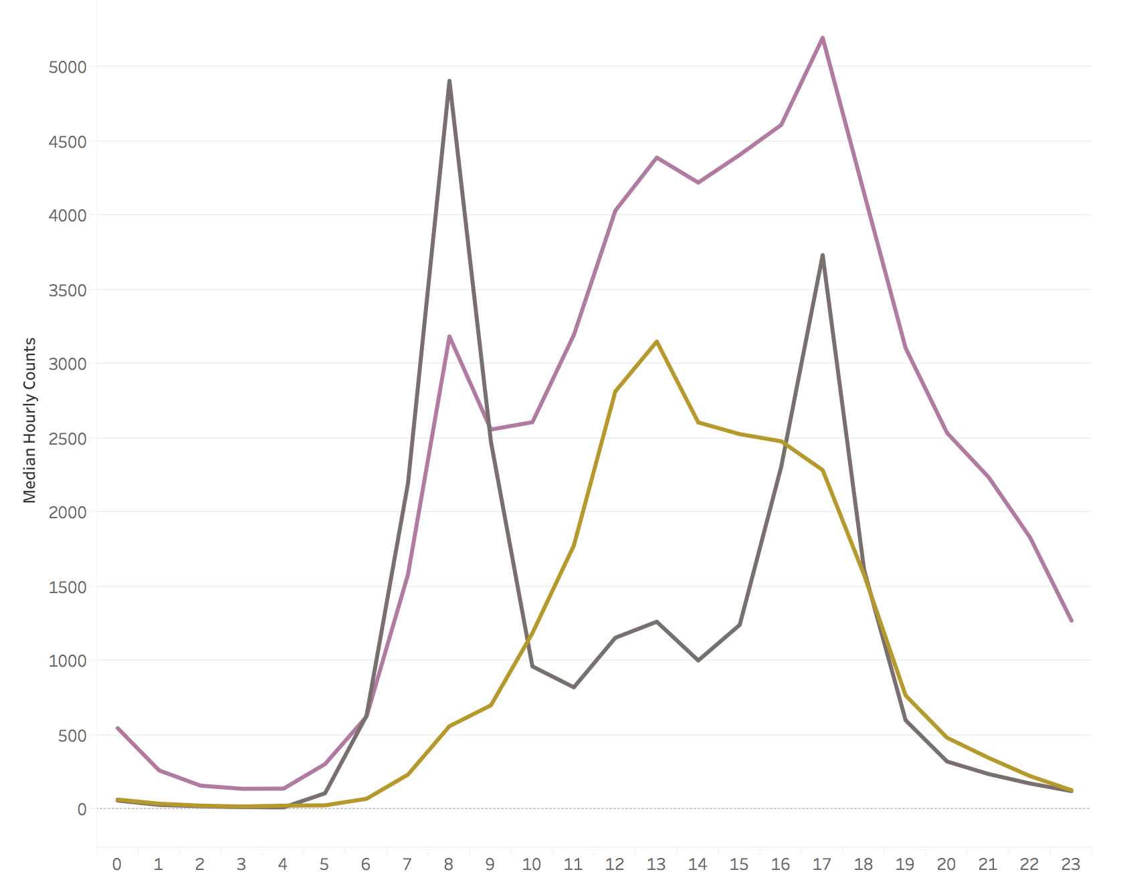
Which areas are Commuter / Casual?
Notes:
Knowing I have two specific pedestrian groups with different patterns, namely Commuters and Casuals, I looked across all different areas to identify which were more Commuter-dominant. Using PCA again, I was able to find these areas very well. In Melbourne, there were 10 locations out of the 42 that were Commuter-dominant. Note that commuter trends also show up in other areas but these 10 locations were the ones used by majority commuters.
Now we know daily patterns, what about month to month, yearly patterns

Slide 10
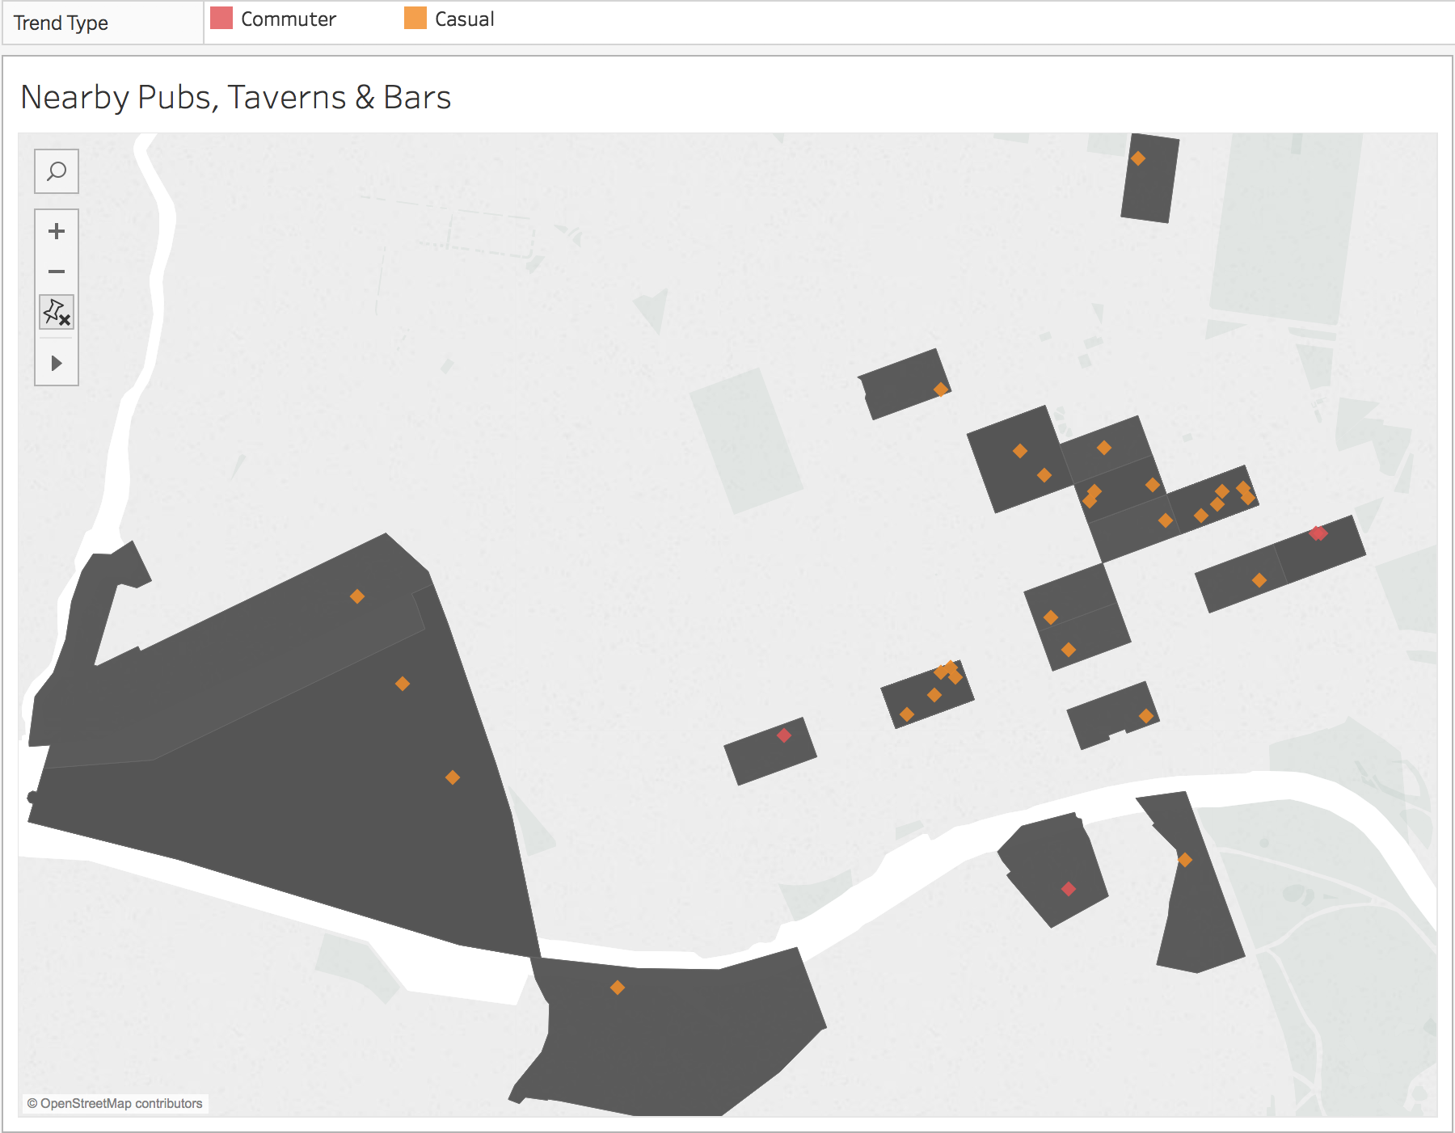
What’s in the Area?
Notes:
Nonetheless, each time I ran my model, several features did pop up as the most important features for predicting: namely surprisingly, or unsurprisingly Pubs & Cafes. Shown above, my Casual labeled areas have more surrounding pubs.

Slide 11
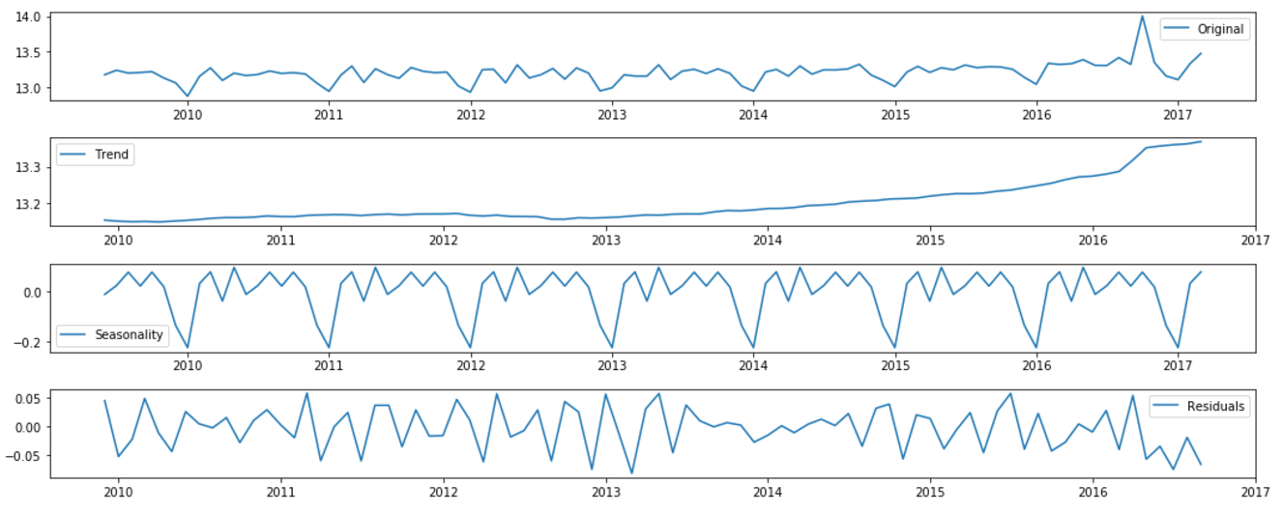
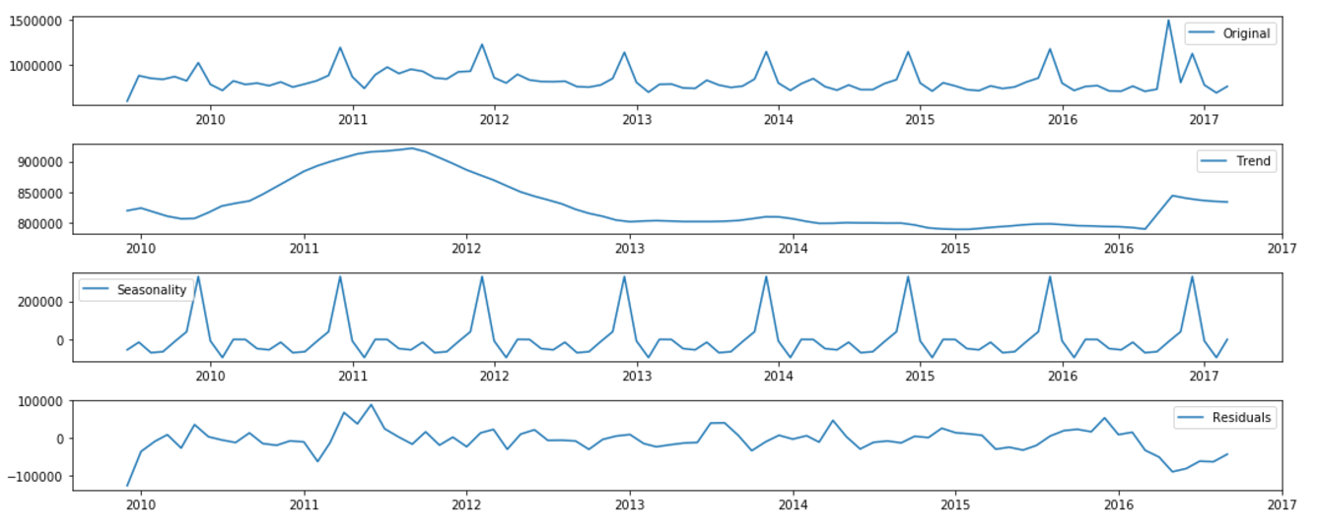
Seasonal Trends (Decomposition)
Commuter
Casual
Notes:
quarterly peaks
Bump towards the later part of the year during the holidays

Slide 12
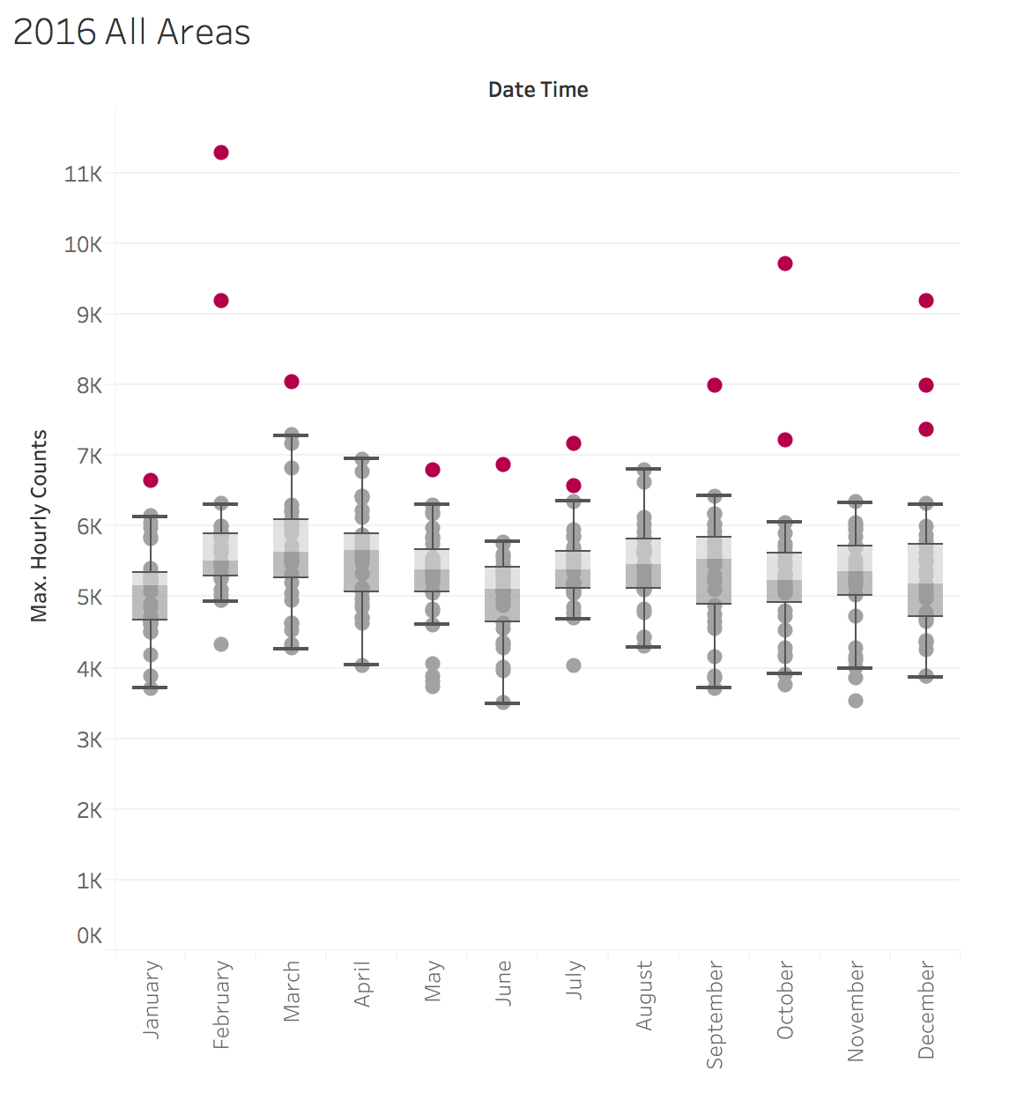
Days where the city is crowded
White Night, Melbourne Marathon, AFL Grand Final, Australia Day, New Years, etc
Notes:
Whilst we know the trends, events in cities will have massive impact as well

Slide 13
Do our movements have a pattern?
Notes:
Identifying biggest factors that can determine the way a crowd moves and how to manage that throughout a certain period of time. Predicting areas where there will be more people can help city plan for better infrastructure and when to implement these changes (non rush hours).
Understanding crowd movement and their patterns is important. As a city planner, you need to know when’s the best time to do road works. If you close an area down, where are they most likely to divert to and can you manage that increase in capacity? Which areas are going to be crowded when there’s an event in a part of the city and where to put public facilities for that?
Very important to figure out the patterns first and foremost.
Video Source:
Pedestrian simulation | Dynamic route assignment over continuous space
https://www.youtube.com/watch?v=QWuHTXufElU

Slide 14
Thank You
Notes:
Different individuals that make different choices everyday. But we all follow a certain pattern depending on our surroundings or the place we live in.
Take this as an example of exiting a venue after a concert is done. everyone starts crowding towards the exits. Usually the exits are highlighted for us, there’ll be a couple of exits. A lot of us are going to follow the crowd to the nearest one, some of us know certain exits are closer to our cars, so we’ll move to those. But it’s with this majority that we can identify patterns with.
Video Source:
Pedestrian simulation | Dynamic route assignment over continuous space
https://www.youtube.com/watch?v=QWuHTXufElU

